Slide 1
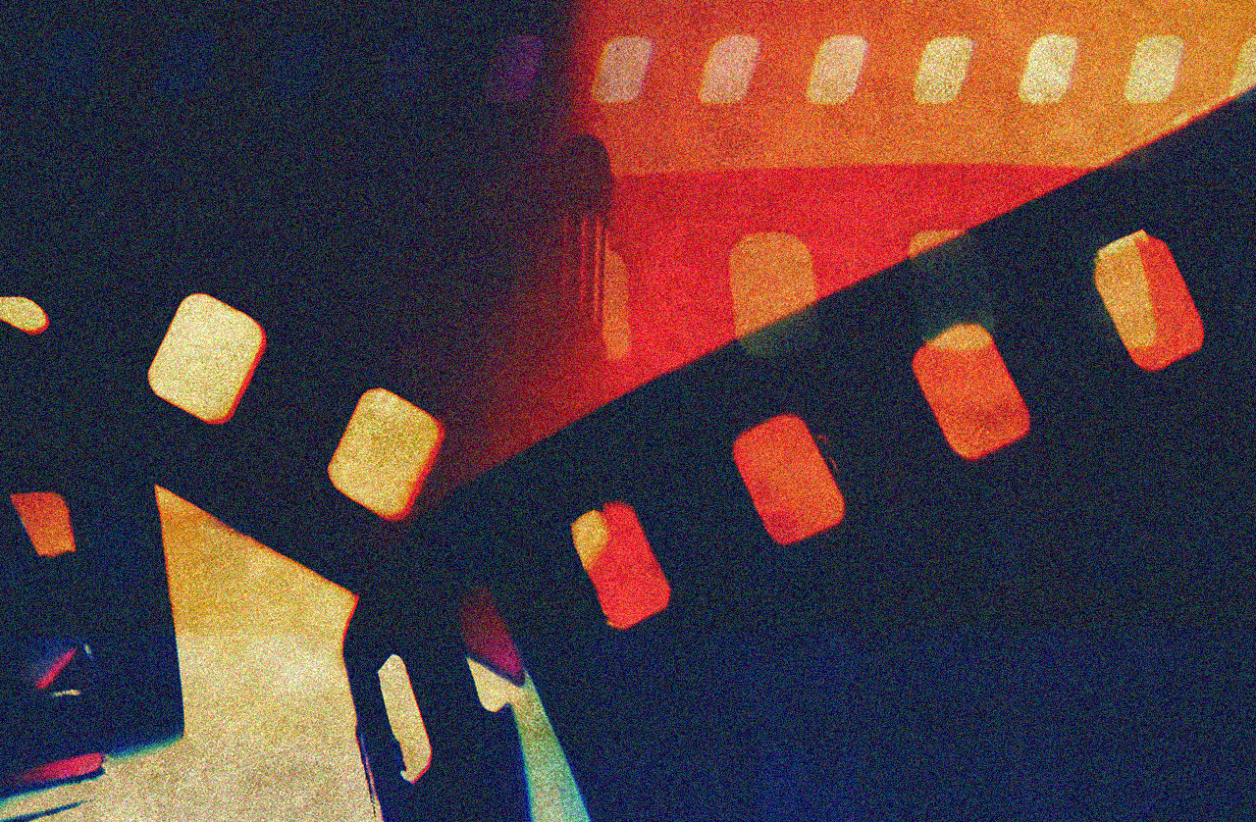
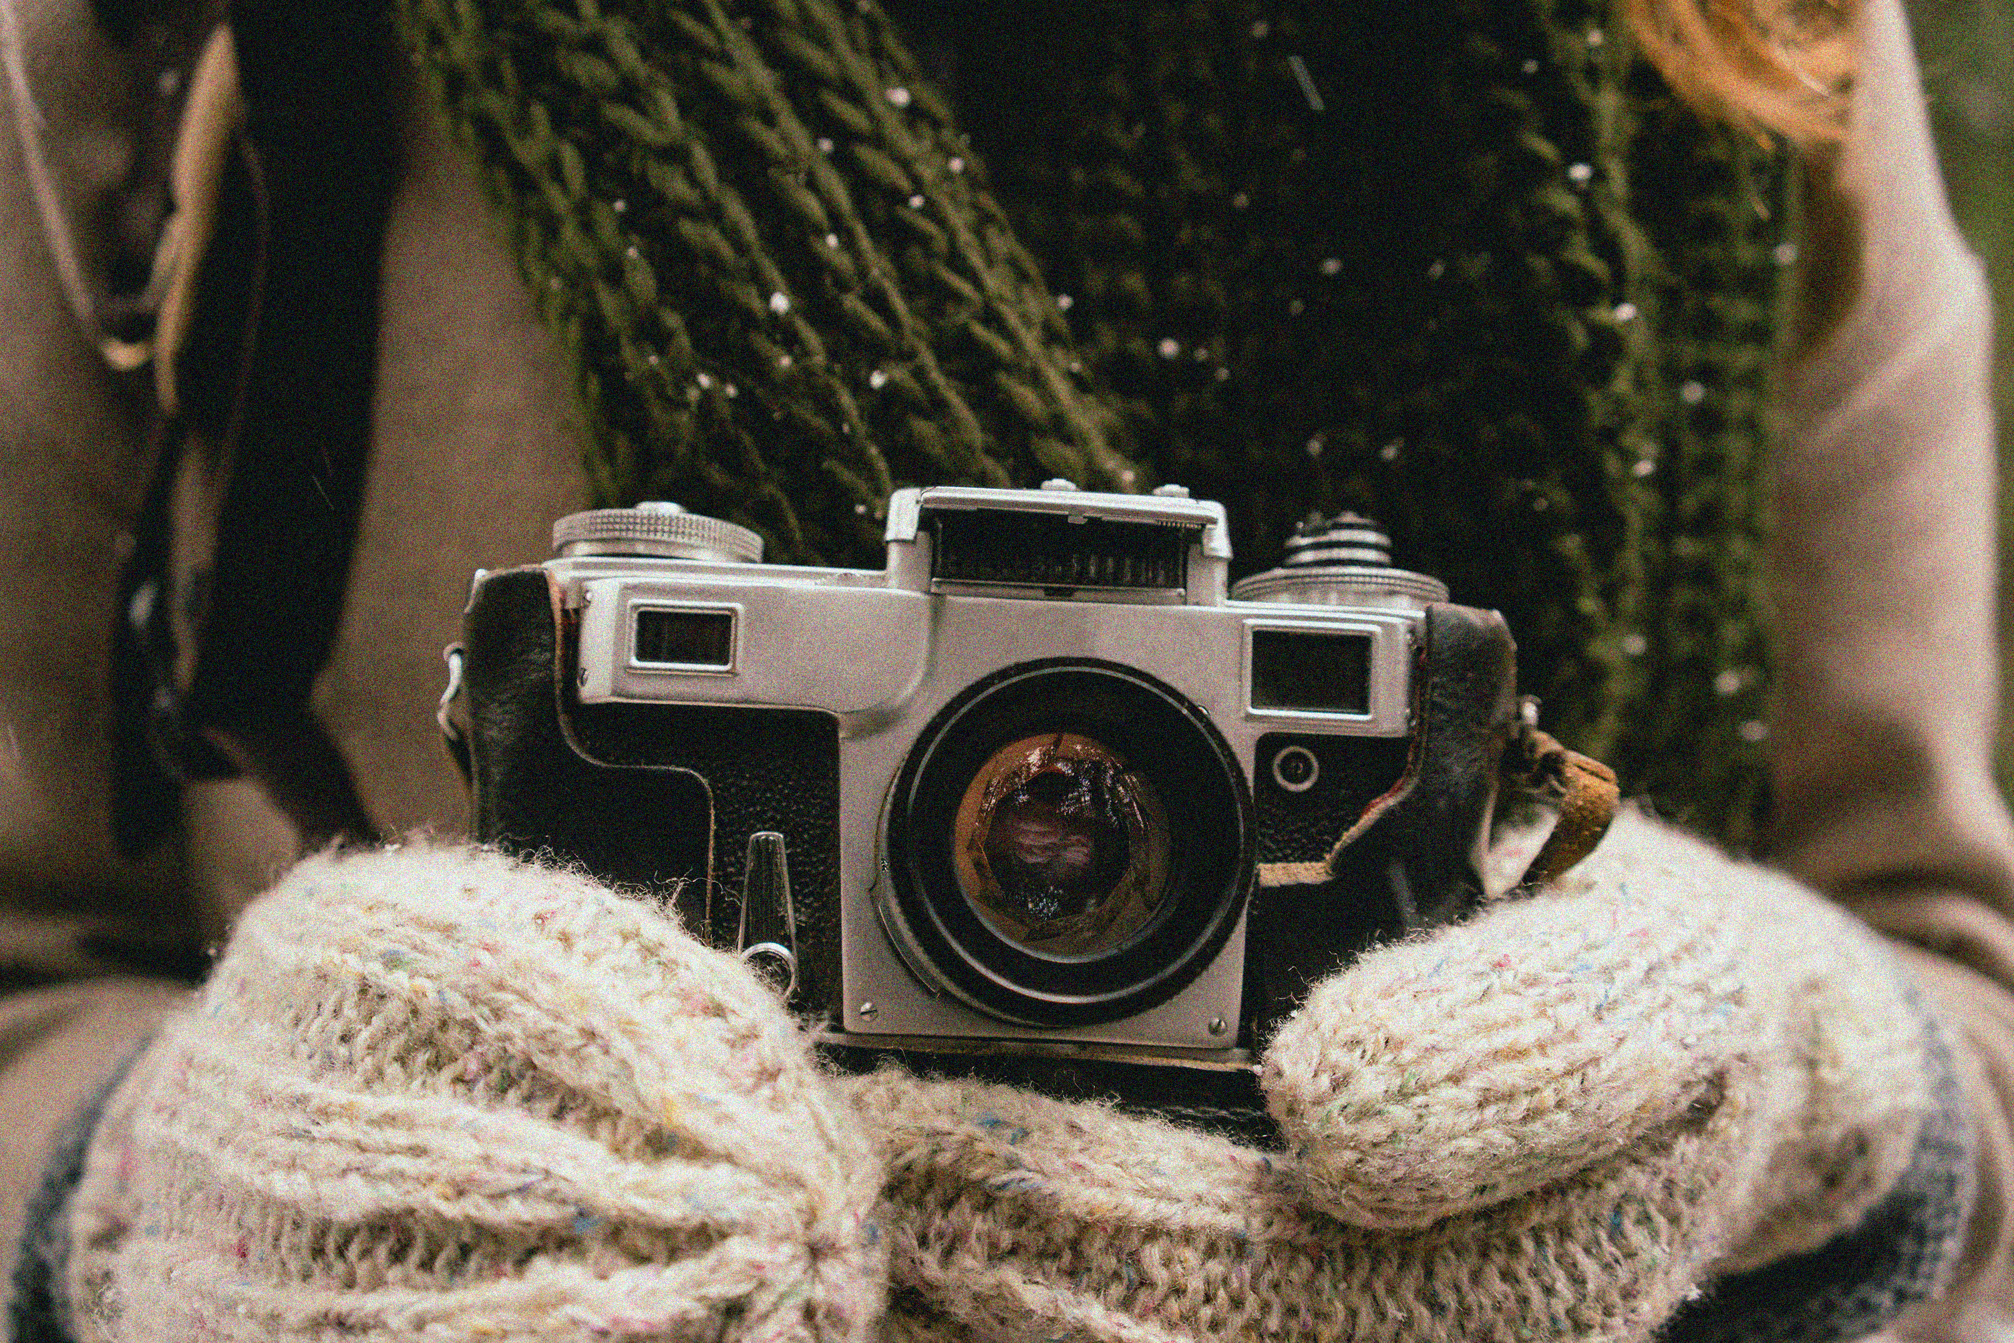
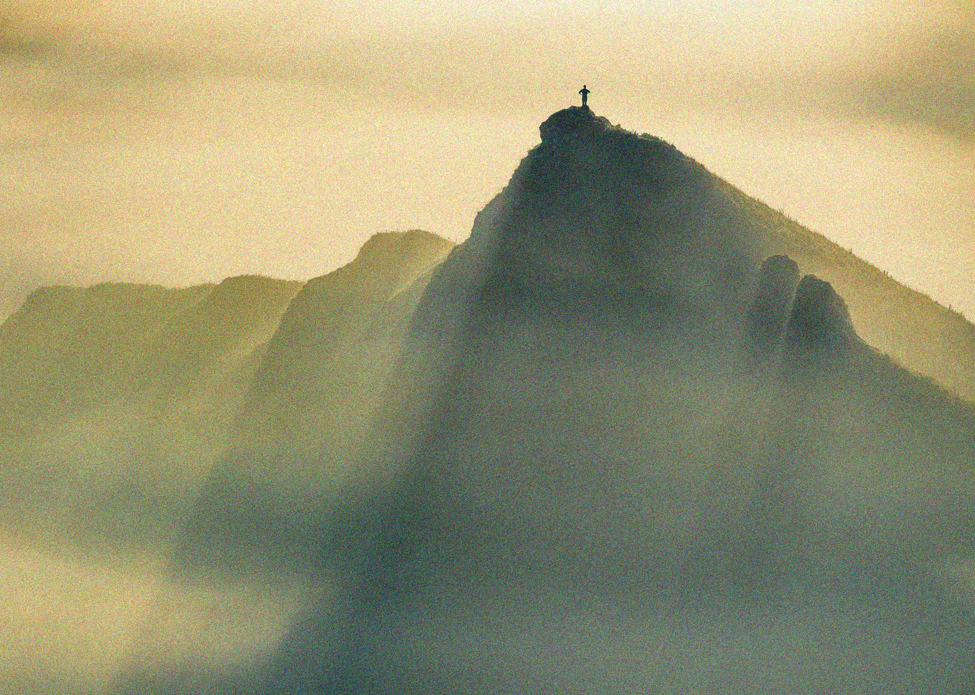
APP PHYSICS 157
COMPUTATIONAL ANALYSIS AND MODELLING
DIGITAL IMAGE FORMATION and ENHANCEMENT
IMAGE AND VIDEO PROCESSING – MODULE 1
NINO PHILIP RAMONES
2020 – 05616
MARCH 10, 2023

Slide 2
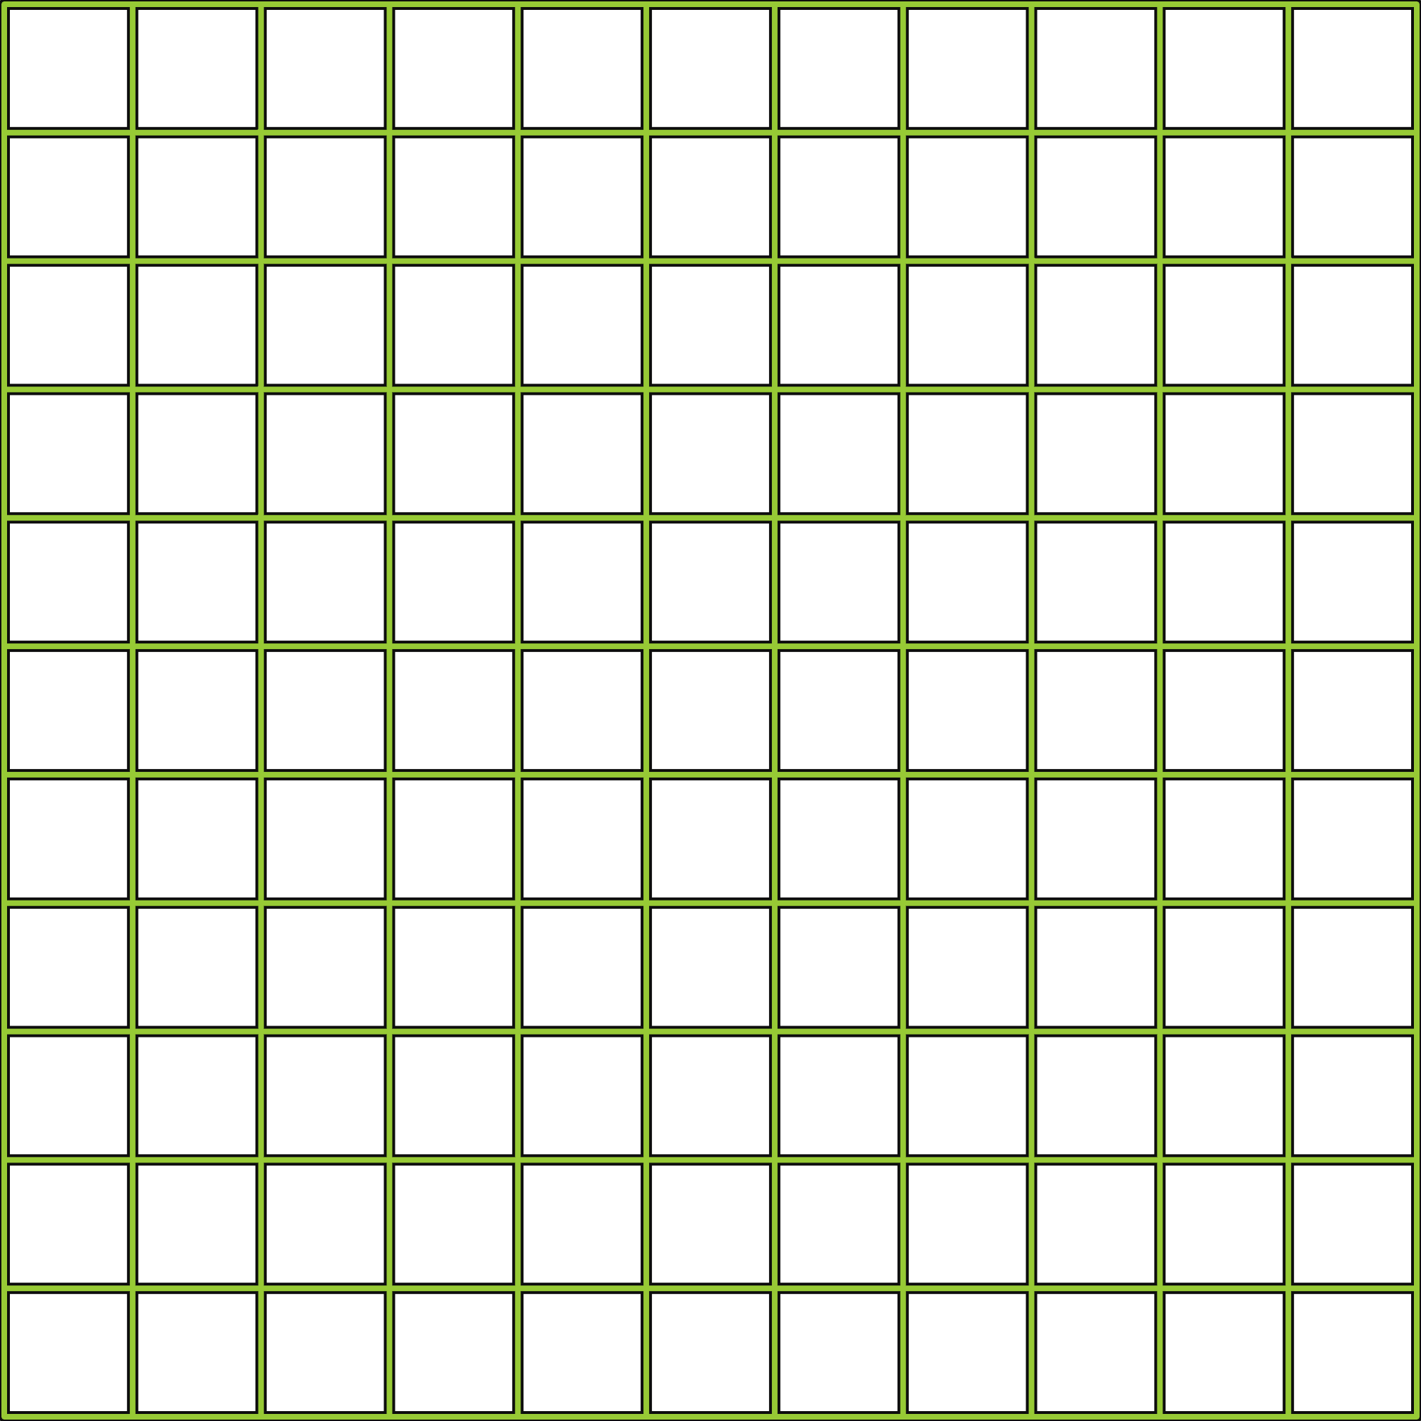
APP PHYSICS 157
DIGITAL IMAGE FORMATION AND ENHANCEMENT
OBJECTIVES
Mathematically create images in Python 3
Save an image in an appropriate file format
Use the back projection technique to manipulate the histogram of an image to a desired cumulative distribution
Improve the appearance of gray level and color images by implementing white balancing algorithms
KEY TAKEAWAYS
File formats of images to be used in analysis and modelling do matter!
A colored digital image is formed from the overlay of the three matrices representing the red, green, and blue channels
SOME PITFALLS
Processing an RGB image in float type (0 to 1) resulted to an overflow of pixel compared to integer 0 to 255 representation
This was circumvented through mapping and normalization of values

Slide 3
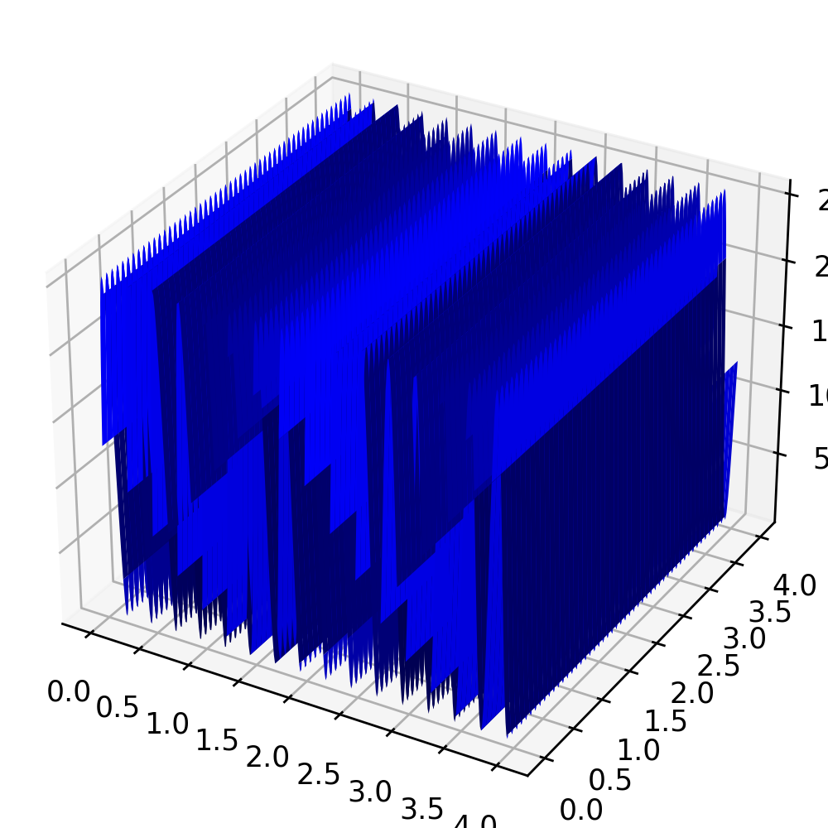
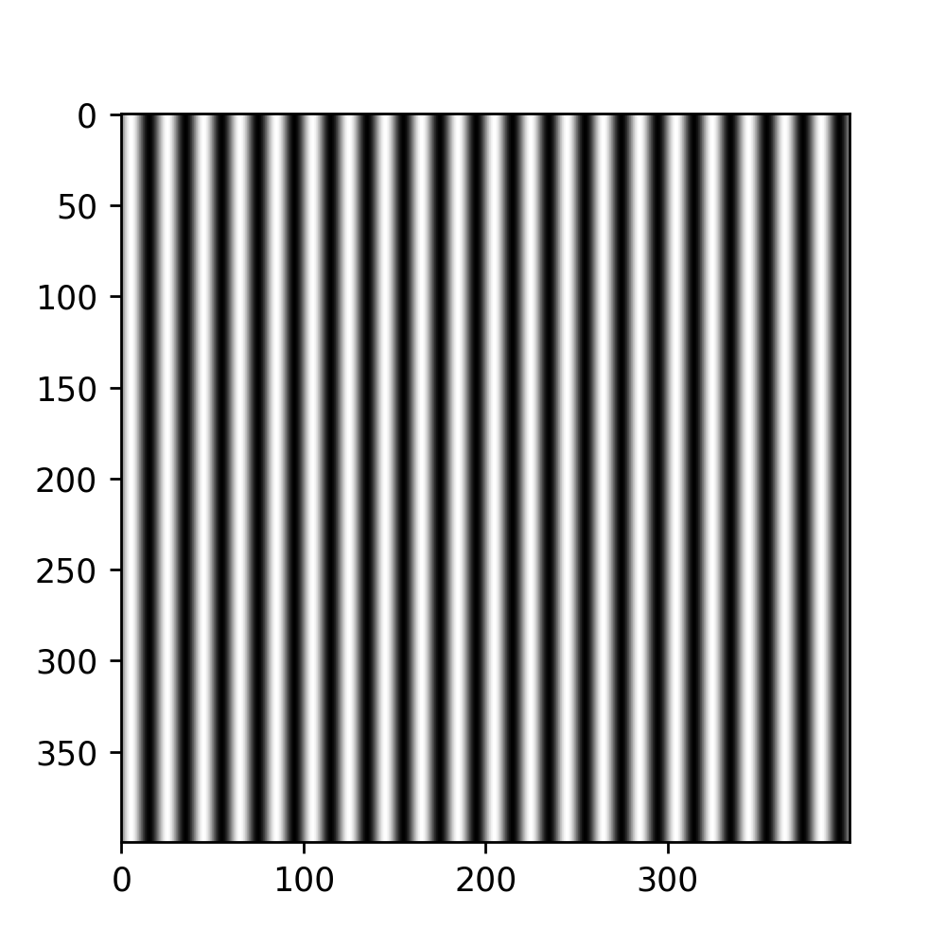
APP PHYSICS 157
DIGITAL IMAGE FORMATION AND ENHANCEMENT
IMAGE DIY
The first part of the activity involves the creation of synthetic images through mathematical representations. A series of 4 cm by 4 cm (not to scale) optical elements confined in a 400 pixel by 400 pixel were made as shown.
Sinusoid along the x-direction with frequency of
4 cycles per cm
Grating with frequency of 5 lines per cm

Slide 4

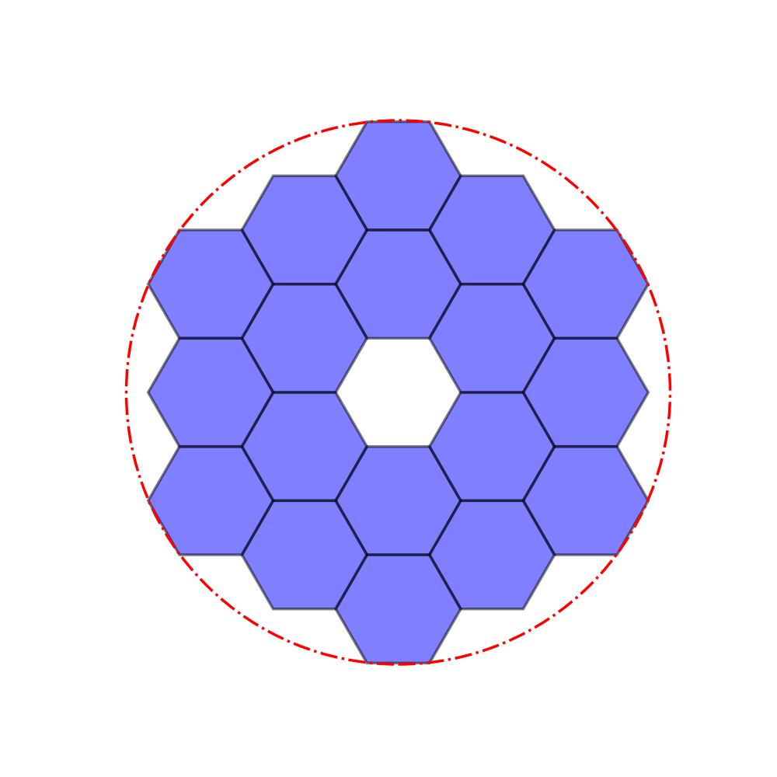
APP PHYSICS 157
DIGITAL IMAGE FORMATION AND ENHANCEMENT
The Hubble’s primary mirror and James Webb space telescope were also synthetically created using Python and some of its built-in libraries for polygon creation.
Circle with a hole in the middle (annulus)
Hexagonal array circumscribed by a circle
The code in generating the inner hexagon array was patterned from Stackoverflow in courtesy of user named tmdavidson. The rest was executed by trial and error for centers.

Slide 5
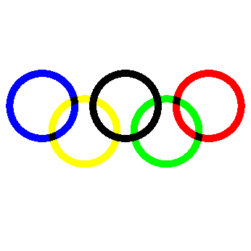
APP PHYSICS 157
DIGITAL IMAGE FORMATION AND ENHANCEMENT
COLOR IMAGE
Using the principle of color subtraction and RGB channel overlaying, the Olympic logo was generated. Color subtraction was used as the value that is part of the ring becomes zero, otherwise, it retains its original value – using the np.where( ) function.
Mathematically created Olympic logo

Slide 6

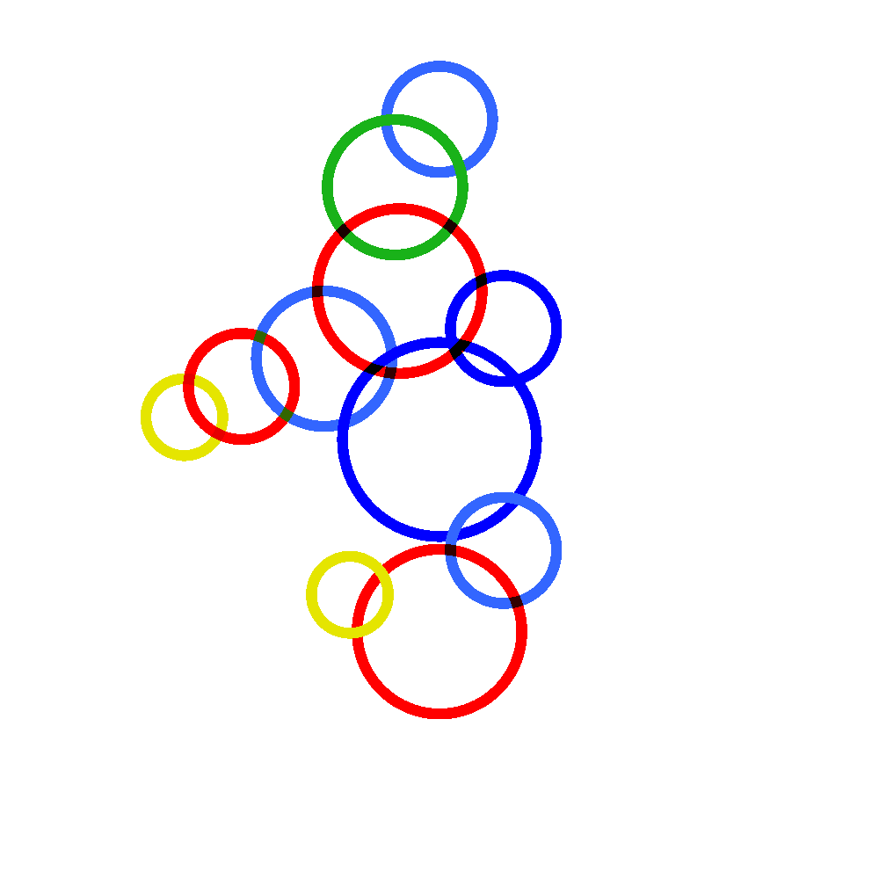
APP PHYSICS 157
DIGITAL IMAGE FORMATION AND ENHANCEMENT
Upon feeling inclined in doing the Olympic logo, the Philippine sea games logo was also recreated in codes. Using the same method and algorithm from the previous activity, the circles also vary in centers, radii, and colors as well.
Original sea games logo. Image from Esquiremag.
Mathematically created sea games logo

Slide 7
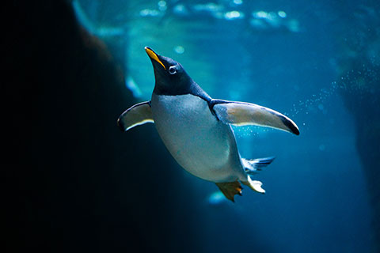
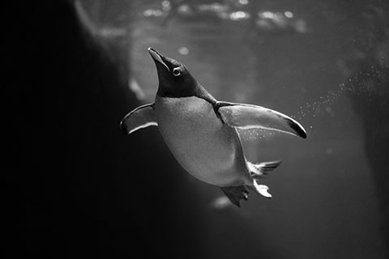
APP PHYSICS 157
DIGITAL IMAGE FORMATION AND ENHANCEMENT
COLORED TO GRAYSCALE IMAGE
The working image was initially imported to the notebook and was converted to grayscale image. The original image has a maximum value of 1, which was then scaled to 255 for the grayscale while accounting for the 8-bit representation of channels.
Original image (0 to 1)
Original grayscale image (0 to 255)
An image of a cute, modest penguin swimming in the ocean was the test subject for activity. PIL library was also used in converting the image to grayscale as well mapping the values to 8-bit.

Slide 8
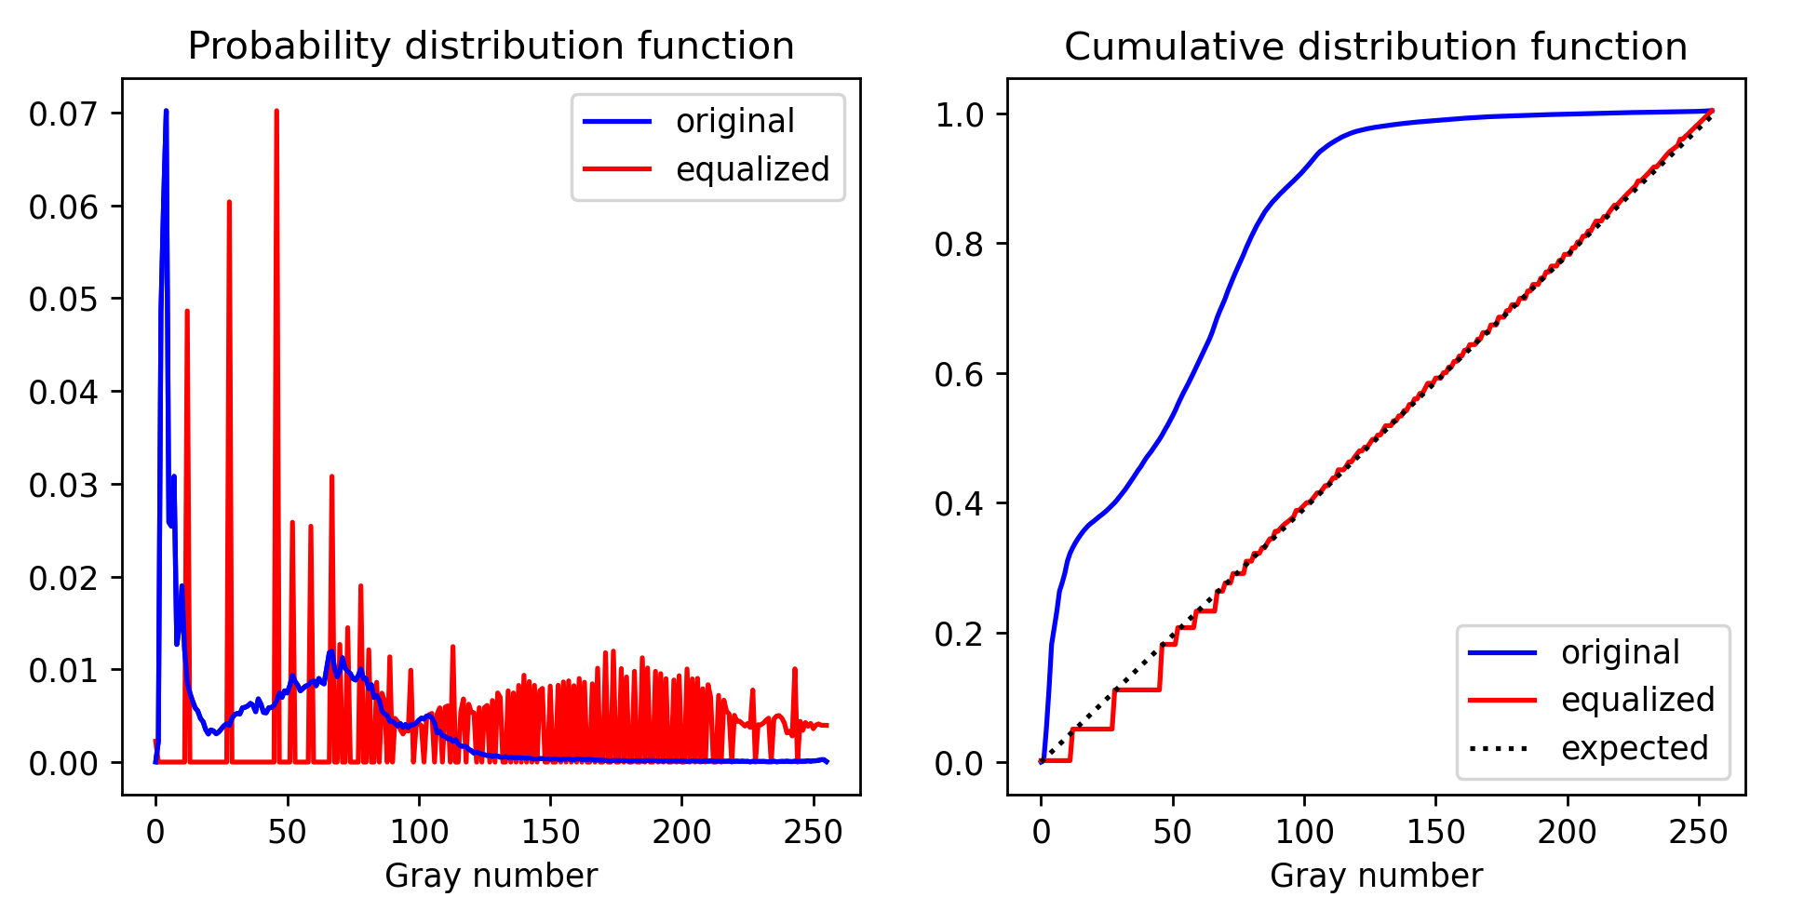
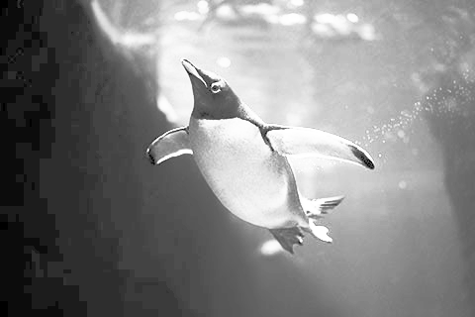
APP PHYSICS 157
DIGITAL IMAGE FORMATION AND ENHANCEMENT
HISTOGRAM MANIPULATION – LINEAR CDF
Original image
Histogram equalization of the image was performed by interpolating the initial CDF to a linear CDF. A contrast difference between the equalized image and the original is apparent as the gray number distribution on the histogram were modified. This modification resulted in the linearized image being much brighter than the original gray image, i.e the most frequent gray numbers or intensity values were effectively spread throughout the range.
Histogram equalized image

Slide 9
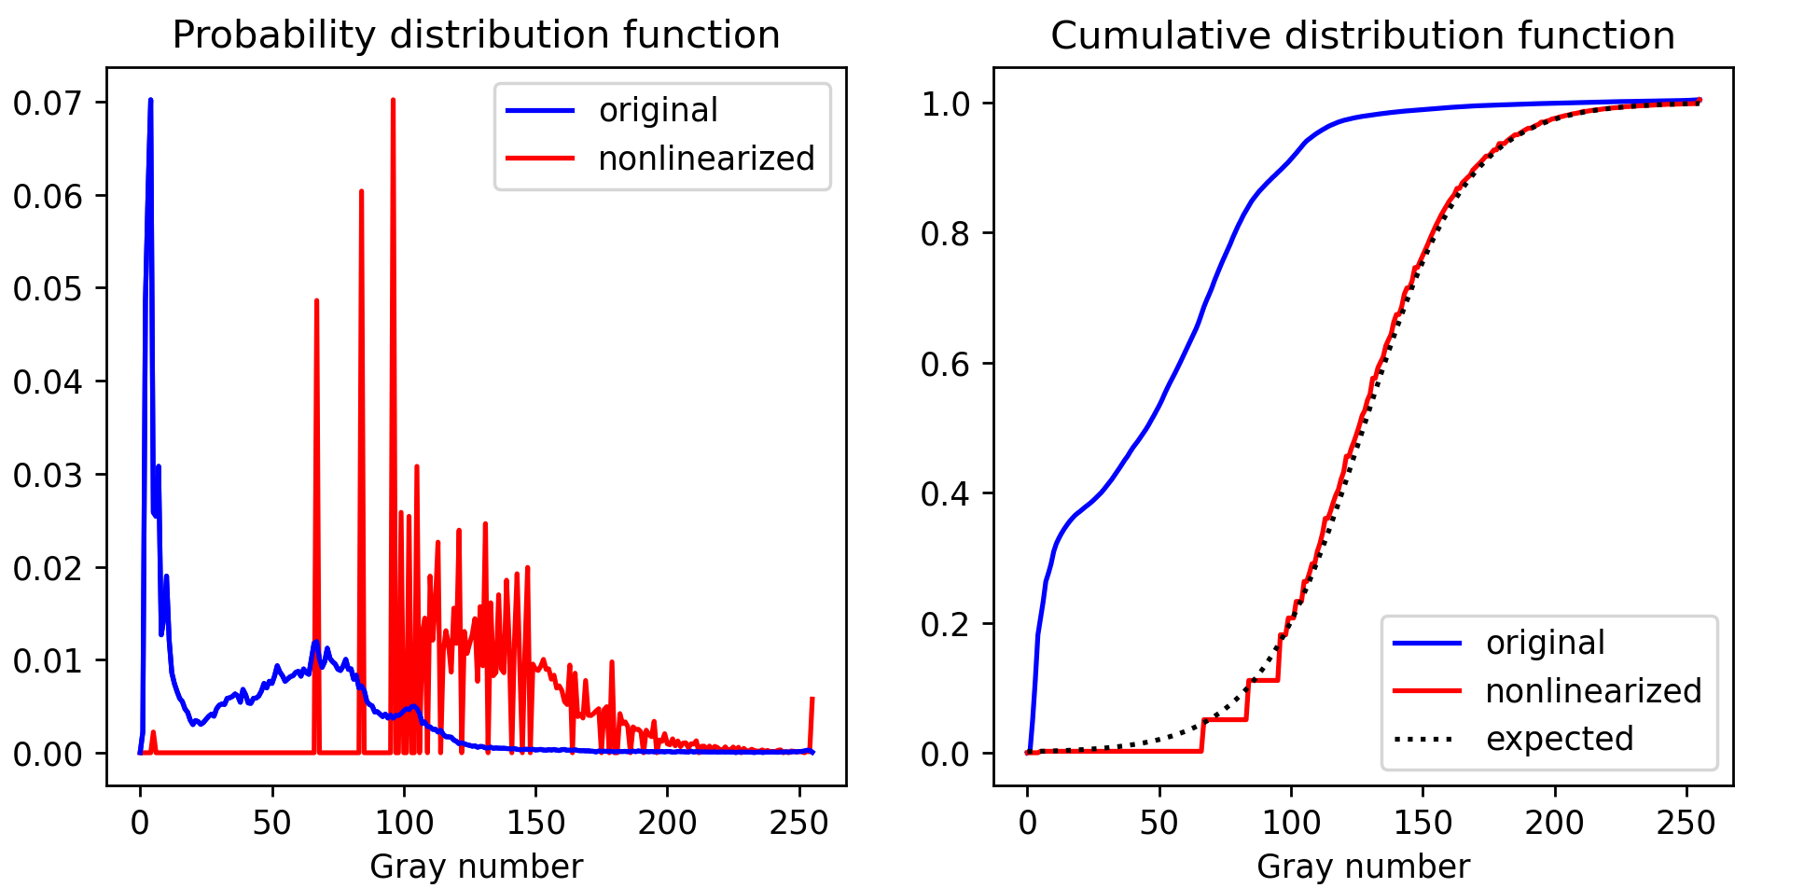
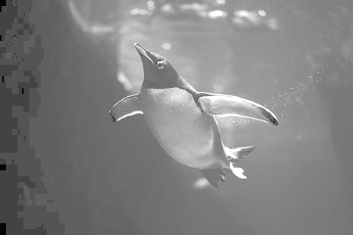
APP PHYSICS 157
DIGITAL IMAGE FORMATION AND ENHANCEMENT
HISTOGRAM MANIPULATION – NONLINEAR CDF
Original image
The case of a nonlinear CDF taking the form of a sigmoid was also examined to imitate the response of a human eye. Compared to the linear CDF, the sigmoid CDF of the resulting image tend to have an overall gray appearance, which is expected based on the PDF, i.e. peaks at the middle gray numbers. The resulting image also tend to be grainier on the darker areas, which can be attributed to the PDF being almost zero at low gray values (around 0 to 50).
Nonlinearized image

Slide 10
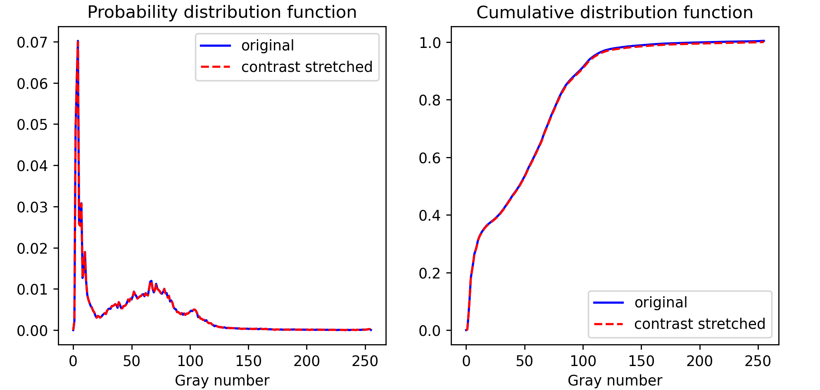
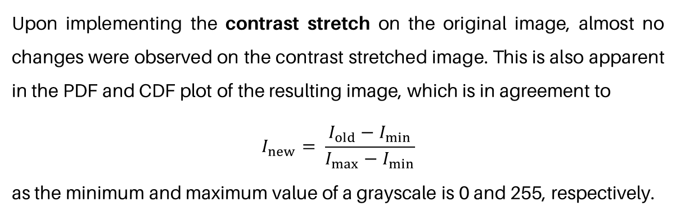
APP PHYSICS 157
DIGITAL IMAGE FORMATION AND ENHANCEMENT
CONTRAST STRETCHING
Original image
Upon implementing the contrast stretch on the original image, almost no changes were observed on the contrast stretched image. This is also apparent in the PDF and CDF plot of the resulting image, which is in agreement to
$$I_{new}= \frac{I_{old}−I_{min}}{I_{max}−I_{min}}$$
as the minimum and maximum value of a grayscale is 0 and 255, respectively.
Contrast stretched image

Slide 11
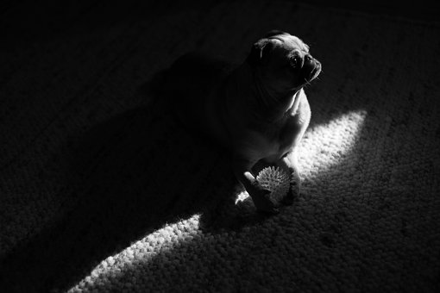
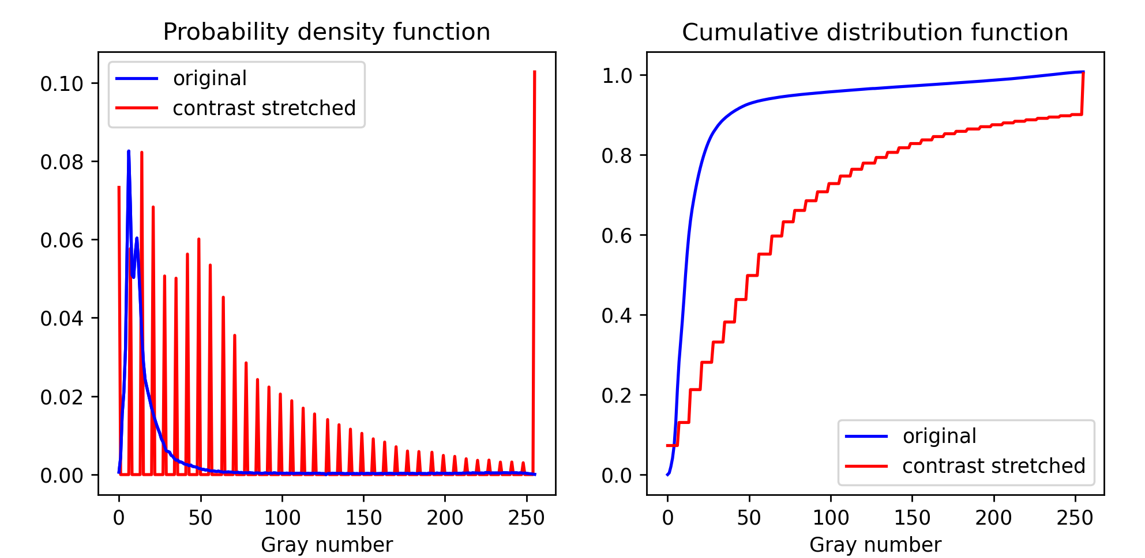
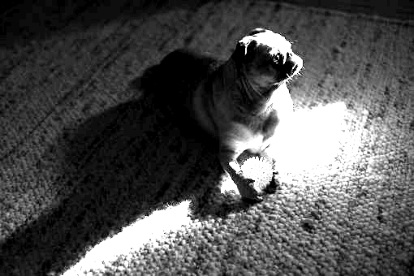
APP PHYSICS 157
DIGITAL IMAGE FORMATION AND ENHANCEMENT
CONTRAST STRETCHING
Original image
Another image that is much darker than the previous image were also considered. By choosing the lower 5th and upper 90th percentile as the minimum and maximum value for the algorithm, we can observe that the resulting image is in high contrast compared to the original grayscale. This is also evident in the PDF and CDF plots shown as the gray values are much now much more spread to the contrast stretched image.
Contrast stretched image
A cute pupperino basking in the sunlight from Pixabay.

Slide 12




Slide 13



presented by
Greta Mae Evans

Slide 14



Slide 15


Thank you
I really appreciate your time.
www.reallygreatsite.com

